Slide 1
Original ownership, transfer of rights, and post-transfer measures
ALAI, 10 October 2025

Slide 2








Slide 3

The Audiovisual Sector – Some Practical Thoughts
High Risk
High Investment

Slide 4
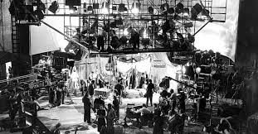
Transfer of Rights & Unification of Rights in the Producer
Specificities of the AV sector:
Contributors often number in the hundreds, and sometimes thousands.
Package of cleared rights in the AV producer:
Crucial to develop, finance, promote and distribute the work.

Slide 5

The Importance of Exclusive Rights
Authorise or Prohibit
Means of fostering and rewarding human creativity
Direct licensing: cornerstone of audiovisual content creation and exploitation

